Slide 1
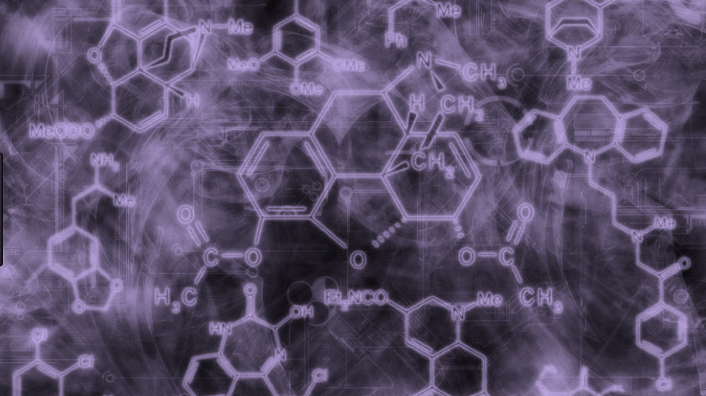

Chemtris
WIP #1
Sindhu Avuthu, Eugene Reznikov, Mohamed A El Tahaway
Biomolecular Science Department
NYU Tandon School of Engineering
June 29th 2017

Slide 2
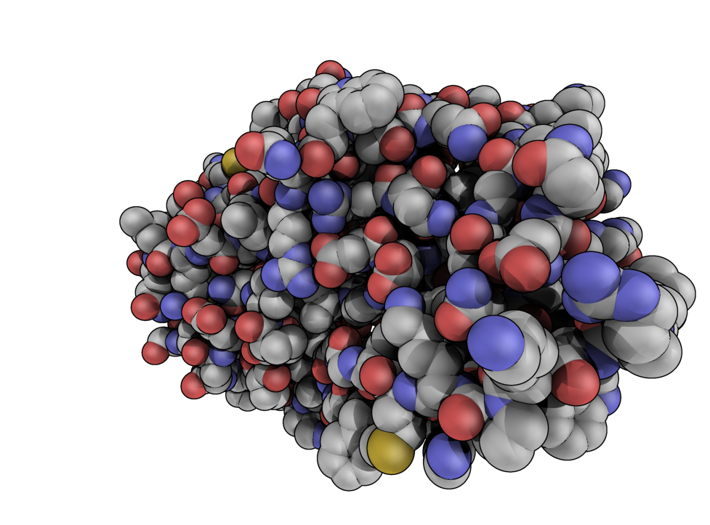
Overview
Objective
Background Information
Previous Research
Changes Made
Progress
To-Do

Slide 3
Objective
Design a three-dimensional molecular modeling video game
Present complex organic chemistry concepts in intuitive way
Molecular visualization
Physical representation, bonding
Hydrophobicity/hydrophilicity, chirality, and polarity.
*
‹#›

Slide 4
Background Information
Organic chemistry is the study of the chemistry of most carbon-containing compounds
Biochemistry is the study of chemical processes related to living organisms.
Students find understanding these subjects difficult
They involve unfamiliar abstract concepts
Macroscopic chemistry is observable and thus more relatable to students
To teach organic chemistry/biochemistry, we use two kinds of representations:
microscopic (arrangement of molecules and atoms to explain chemical phenomena)
symbolic (representation by symbols, numbers, and equations)
*
‹#›

Slide 5
Background Information
Microscopic and symbolic representations depict abstract unobservable concepts
Limited by the medium in which they are presented
two-dimensional textbook models
three-dimensional mechanical models
Three-dimensional computer models present a more accurate representation of molecules
Dimensional, intermolecular and intramolecular properties
Three-dimensional molecular models allow students to:
create and analyze models
translate representations
make linkages between 2D and 3D models
*
‹#›

Slide 6
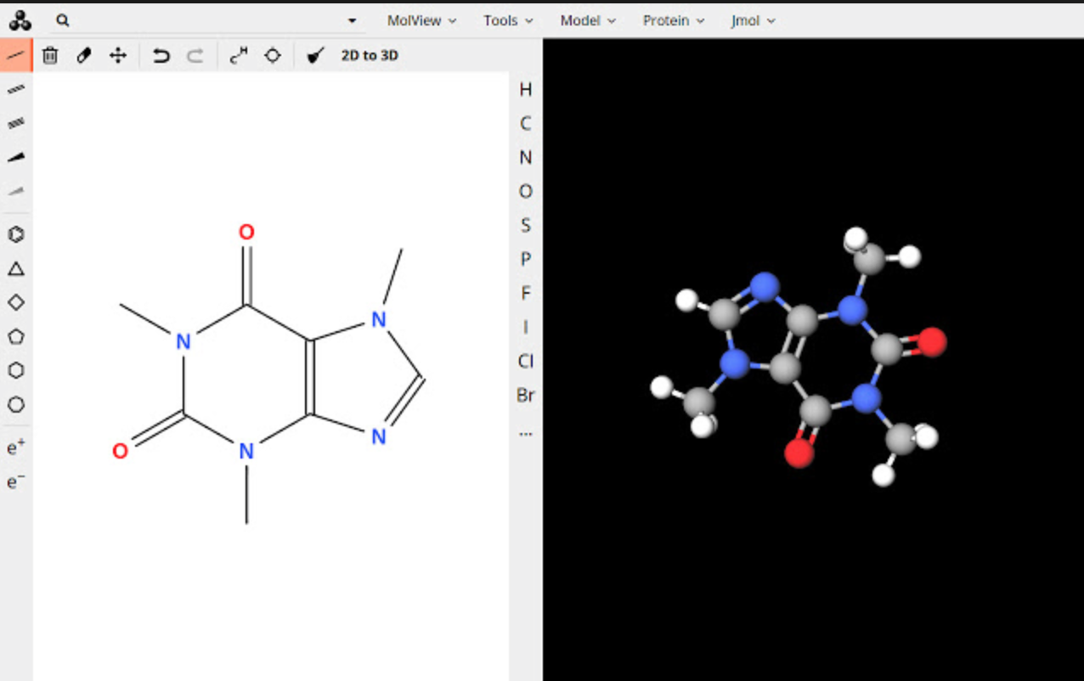
Previous Research
eChem is an existing computational 3-D molecular modeling educational tool
molView is an open-source web-based data visualization platform for molecular models
Combining 3D molecular modeling with a video game structure makes molecular visualization more interactive, enhancing student learning
Figure 1: molVIEW interface
Source; Google Images
*
‹#›

Slide 7
Methods
LibGDX
Pros
Natively runs on Android, iOS and Desktop without need for an emulator
Robust functionality
Cons
Lack of documentation
Low-level language (requires writing more code)
*
‹#›

Slide 8
Methods
Unity
Powerful but easy-to-learn game development environment
Supports building for mobile and VR platforms
Well-documented
Script-based
*
‹#›

Slide 9
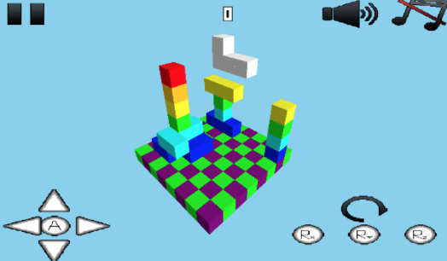
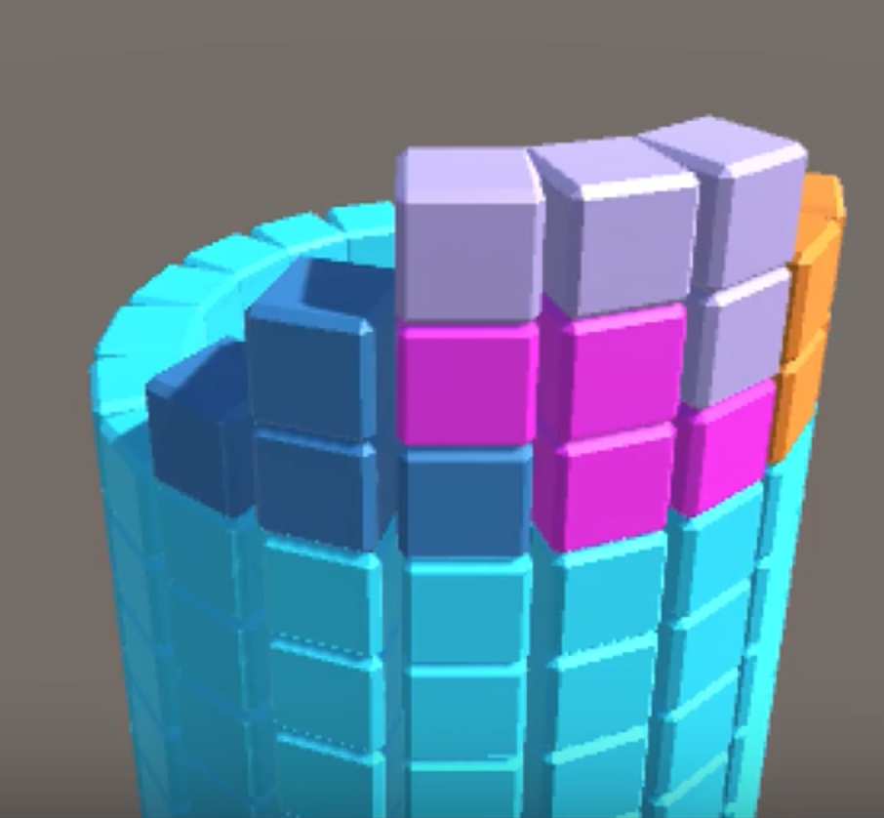
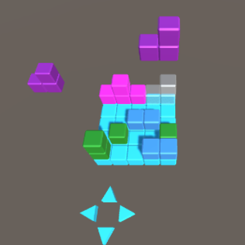
Changes Made to Existing Game
3D tetris -> spherical tetris -> cubical tetris
Code written in libGDX and later converted into Unity
Figure 2: Version 1 (3D tetris)
Source: MD Kabir, 3D Tetris WIP, 7/5/2015
Figure 3: Version 2 (Spherical tetris)
Source: Mohamed A El Tahawy, Chemtris Demo (Alpha Stage),
6/4 2017
Figure 4: Version 3 (Cubical tetris)
*

Slide 10
Progress
Preview of the next piece in the top left corner
Score is based on how fast pieces land
Filling in a level (like a line in Tetris) clears the stage and advances the level by 1
Stacking blocks of opposing polarity results in a point penalty
Also scatters blocks in random directions
Improved overall look of the game
Brighter colors to distinguish pieces, background images
Modified rotation from 360 degree rotation
Converted previous code from libGDX and coded levels 1-10 in Unity
*
‹#›

Slide 11
Level System Implementation
Level 0: 3x3 grid and only a single 1x1x1 cube (tetromino) is allowed.
Level 1: 4x4 grid with 1x1x1 and 1x2x1 pieces
Level 2: 5x5 grid with 1x1x1 and 1x2x1 pieces
Level 3: 5x5 grid with 1x1x1, 1x2x1, and 3-block L shaped pieces
Level 4: 5x5 grid with 1x1x1, 1x2x1, L-shaped, and 4-block T-shaped pieces
*
‹#›

Slide 12
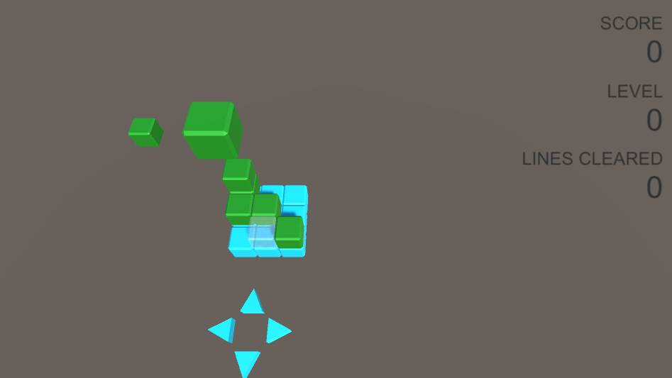
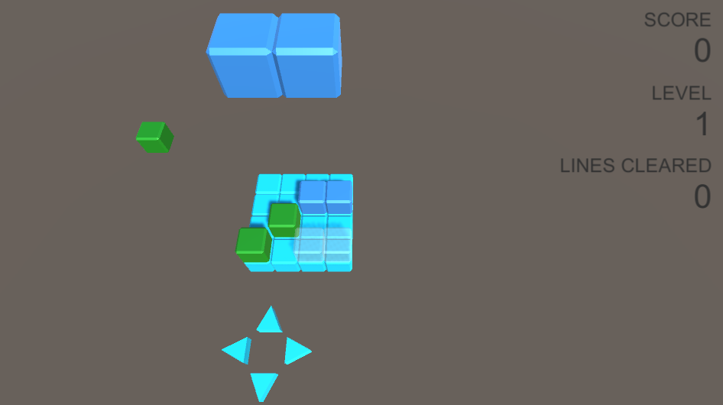
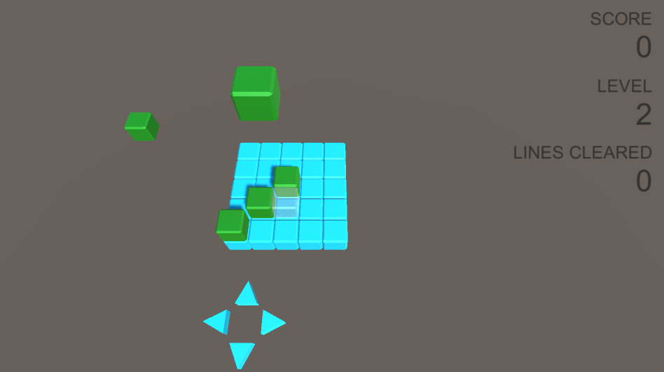
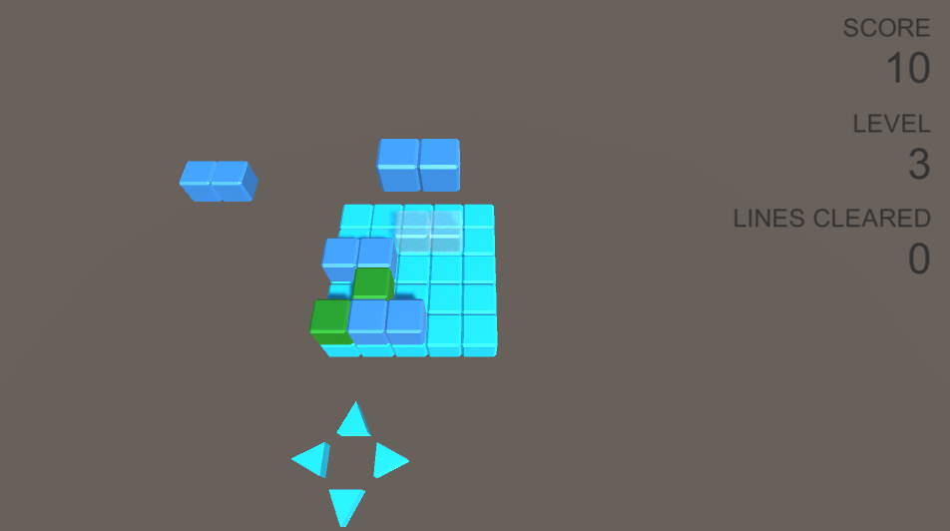
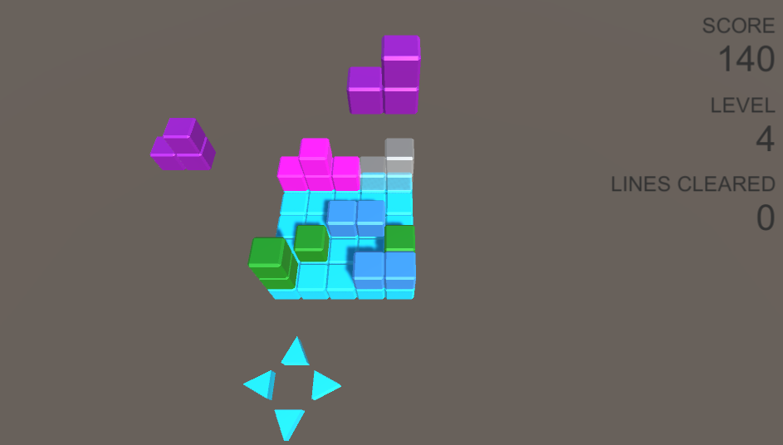
Levels 1-4
*
‹#›

Slide 13
Level System Implementation
Level 5: 2x2x1 square piece introduced
Level 6: Grid expands to 6x6.
Level 7: Grid expands to 7x7.
Level 8: Grid expands to 8x8.
Level 9: Grid expands to 9x9 and Z and S shaped tetromino pieces are introduced.
Level 10: Grid expands to 10x10 and introduces polarity: yellow cubes are non-polar/blue cubes are polar, and placing cubes of opposite polarities on top of each other will scatter them across the grid
*
‹#›

Slide 14
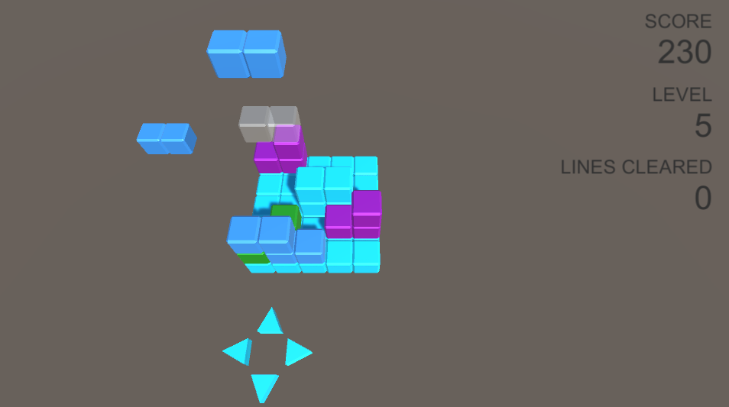
Levels 5-10
*
‹#›

Slide 15
To-Do
Functional
Implement stage rotation
Optimize piece rotation in three dimensions
Implement touch compatibility so that the game can be played on phones
Implement an effective point system
Add levels that represent actual molecules and molecular concepts (ex. chirality)
Design
Optimize colors and background
Add sound effects and background music
Create a playable version of the game and get student feedback
3D print game pieces for demonstration purposes
Make Chemtris adaptable to VR (Virtual Reality) platforms
*
‹#›

